Slide 1

D3 Graphs
Dennis Berger
Boran Kaya
Amin Siddique

Slide 2

D3Graph: A Powerful Tool for Interactive Graphs
D3Graph is a JavaScript library for creating dynamic and interactive graph visualizations in web applications. It leverages web standards to offer unparalleled control over your visualisations, making it an ideal solution for bringing data to life.

Slide 3

Introduction to D3Graph
JavaScript Library
Interactive Data Visualization
For dynamic graphs
Make data come to life
Versatile Applications
Social, financial, biological networks

Slide 4

Where is D3Graph Used?
Social Networks
Financial Data
Biological Networks
Organizational Charts
Connections and communities
Transactions and markets
Genes and proteins
Hierarchies and relationships

Slide 5





D3Graph’s Core Features
Interactive Graphs
Customizable Nodes/Edges
Network Analysis
Dynamic user engagement
Tailor appearance
Analyze graph structures
HTML/Jupyter Support
Wide compatibility

Slide 6

Graph Visualization
1
Interactive Graphs
Provides dynamic user engagement.
2
Customizable Nodes/Edges
Tailor the appearance to your needs.
3
Network Analysis
Analyze complex graph structures.

Slide 7
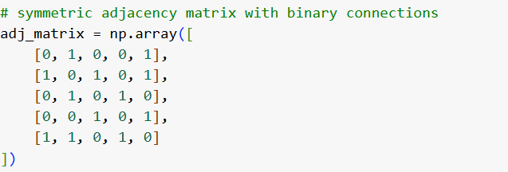
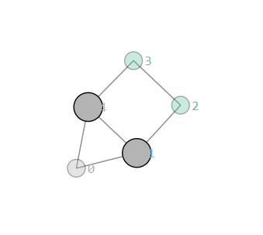

Slide 8
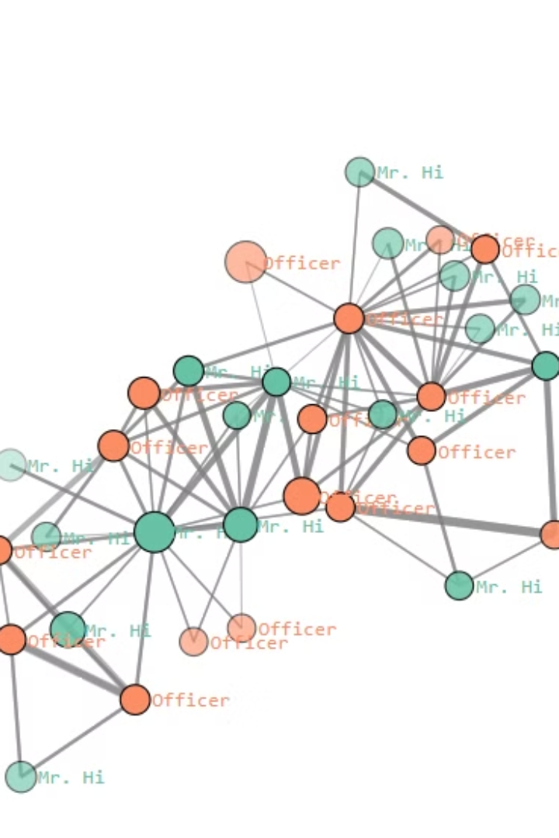
Karate Club Example
A classic example of network analysis.
Visualizes social connections.

Slide 9

Key Takeaways
1
Powerful Tool
2
Highly Customizable
D3Graph simplifies graph creation.
Tailor graphs to specific needs.
3
Versatile
Supports various applications.

Slide 10
Tutorial
Adjacency Matrix
d3Graph
HTML file
Install via pip
pip install d3graph

